Slide 1
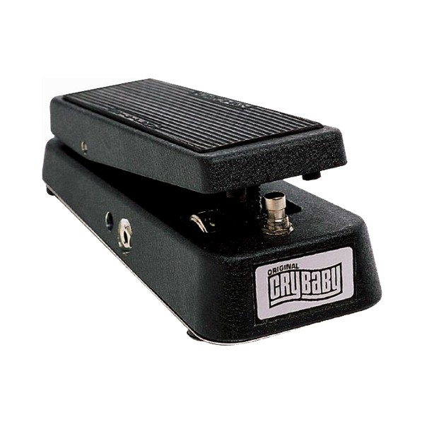
Wah-wah

Slide 2
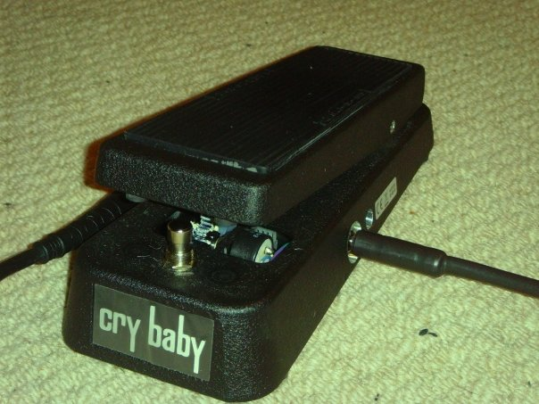
Background
Origins
Originally developed by jazz trumpeters using mutes
Guitar effect since Jimi Hendrix popularised the Vox Crybaby pedal in the late 1960s
Wah-wah pedal
Resonant (high-Q) filter with variable centre frequency
Pedal controls the frequency
Separate knob controls mix between original and filtered signal
The Original GCB95 Cry Baby Wah
Creative commons image from Wikipedia

Slide 3
Resemblance to voice
“Wah-wah” resembles human vocalisation
Spectral characteristics of phonemes [u] & [a]:
Vocal folds are harmonic source filtered by formants depending on shape of mouth
[u] vowel: first formant is around 350 Hz
[a] vowel: first formant is around 700 Hz
[u] to [a] articulation produces modulated sound
Trajectory of 1st formant moves up in frequency
[a] ‘ah’ first formant in range 700-1200Hz
Matches range of resonant peak in wah-wah circuit
Pedal range covers frequencies where first 2 formants overlap
But missing the second formant
Only one resonant peak in wah-wah circuit
Electro-Harmonix “Talking Pedal” uses two peaks
Resonant lowpass filter

Slide 4
Block diagram
x[n]
y[n]
+
1-Mix
Mix
Bandpass or peaking filter with variable center frequency
Variable Mixing

Slide 5
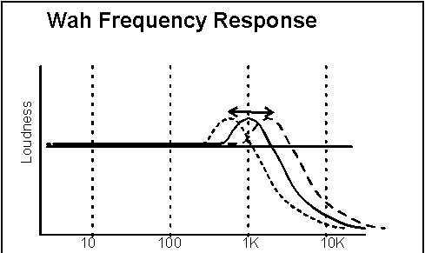
Varieties of wah-wah effects
Resonant (bandpass or peaking) filter
Variable centre frequency
Small bandwidth (i.e. high Q)
Standard wah-wah
Centre frequency controlled by pedal (manual control)
Auto-wah (2 effects)
Centre frequency controlled by LFO
Frequency of LFO usually around 1-2 Hz
OR, could depend on envelope of input signal
Tremolo-wah: also amplitude variations
Centre frequency can vary from near 0 to fs/2
In practice, varies across the midrange frequencies only

Slide 6
Magnitude response of a resonant low pass filter
magnitude 12 dB (G_{c} ~ 20) at ω_{c}=π/2

Slide 7



Auto-wah [part 1]
One auto-wah effect uses a low-frequency oscillator
LFO controls the centre frequency of the filter
Parameters are similar to other LFO effects:
Sweep rate
Sweep width
Minimum frequency
W
fc
fmin
Time

Slide 8
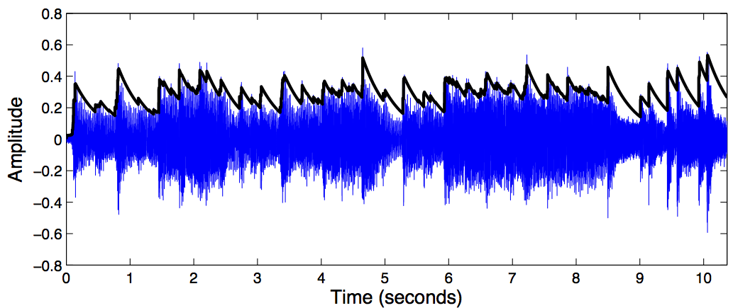

Auto-wah [part 2]
Auto-wah can also refer to an envelope follower wah effect
The centre frequency scales with the signal envelope
Envelope is essentially the local average level of the signal
Envelope is characterised by attack and decay times
How fast does it respond to increasing and decreasing signal?
Generally, attack time is much faster than decay time

Slide 9
Auto-wah [part 3]
Auto-wah can also refer to an envelope follower wah effect
The centre frequency scales with the signal envelope
Envelope is essentially the local average level of the signal
Envelope is characterised by attack and decay times
How fast does it respond to increasing and decreasing signal?
Generally, attack time is much faster than decay time
Other parameters:
Minimum frequency
Sensitivity S

Slide 10
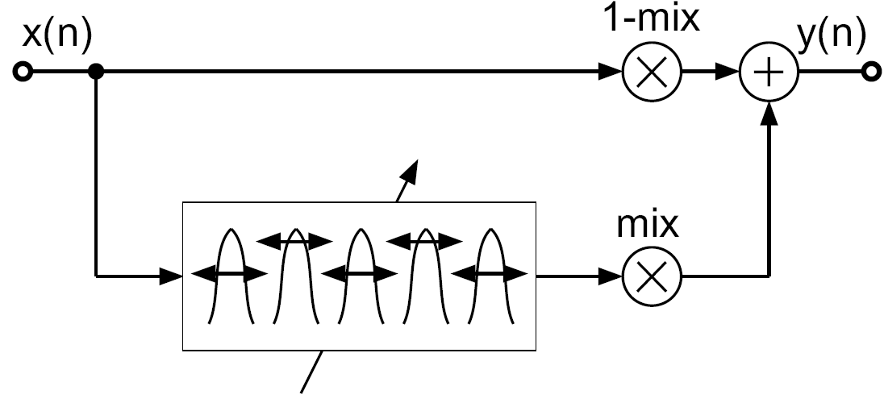
M-fold wah-wah
Replacing the unit delay in the resonant bandpass filter by an M tap delay leads to M-fold wah-wah filter
M bandpass filters are spread over entire spectrum and simultaneously change their center frequency.

Slide 11
M-fold wah-wah
White noise input applied to M-fold wah-wah filter
Periodic enhancement of the output spectrum

